Slide 1



EUROPEAN POLITICAL SCIENCE ASSOCIATION 2026
Voting from the Pew: Religion, Gender, and Roll-Call Voting on the Culture Wars
John McTague, PhD
Shanna Pearson-Merkowitz, PhD
Professor, Towson University
Professor, University of Maryland
Draft Chapter from *For God and Party: Religion, Representation, and American Political Parties* (Cambridge University Press, 2027)

Slide 2



The Book: Investigates Descriptive Representation and the Cultural and Political Evolution of the US Senate
Theory
Chapters
How do political parties develop their brand identities? We explain how and why the two major parties changed over time with a specific focus on the underappreciated role of descriptive representation of political elites, particularly members of the U.S. Senate.
“Descriptive representation” is the concept that members who demographically “look like” their constituents act in ways that best serve those constituents’ interests and preferences.
Introduction
Theory
Description of the religious and party changes of the US Senate since 1969.
Evolution of the abortion debate since 1969 (thematic analysis of floor speeches using qualitative and Machine learning techniques)
Bill Introductions
Voting Behavior (this one!)
Race and Immigration policy in an (almost) all white Senate

Slide 3
The Demographic Sorting of the Senate
THE HIstory of the us political parties
THE MODERN REALITY
Overlapping Coalitions
Identity-Based Sorting
Historically, the Senate featured internally diverse parties. Both political parties contained a plurality of mainline Protestants and some representation of other groups.
Gender and religion, not party, were largely predictive of cultural voting.
Today, polarization is deeply aligned with demographic traits. Modern party caucuses have nearly fully "sorted."
Evangelical and Catholic men dominate the Republican coalition. Meanwhile, women, Jewish, and other minority religious cohorts have sorted into the Democratic Party.

Slide 4

Senator Religion Data Collection
PRIMARY ANALYTICAL CATEGORIES
METHODOLOGY
Archival Research
We systematically mapped political careers back to historic records, creating a validated profile of religious identity for every serving Senator.
Evangelical Protestant
A primary anchor of the cultural Right, serving as a core ideological block.
Catholic
Historically complex cohort characterized by high partisan capture and split.
Mainline Protestant
The traditional historical baseline of the Senate institutional chamber.
Jewish
Strongly aligned with progressive advocacy and the modern cultural Left.
TIME HORIZON
55-Years of Data
The database spans continuously from 1969 to 2024, capturing structural demographic shifts and realignment trends over five decades.
LDS (Mormon)
Cohesive conservative voting patterns shaped by state demographics.
Other / Secular
Non-traditional religious affiliations and unaffiliated senators.

Slide 5
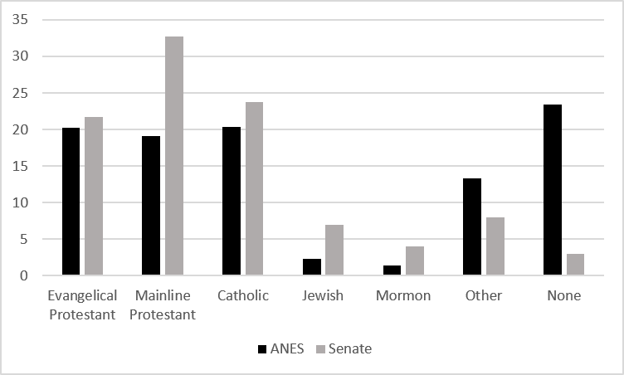
As of 2020, Most religious groups were over-representated in the US Senate.

Slide 6
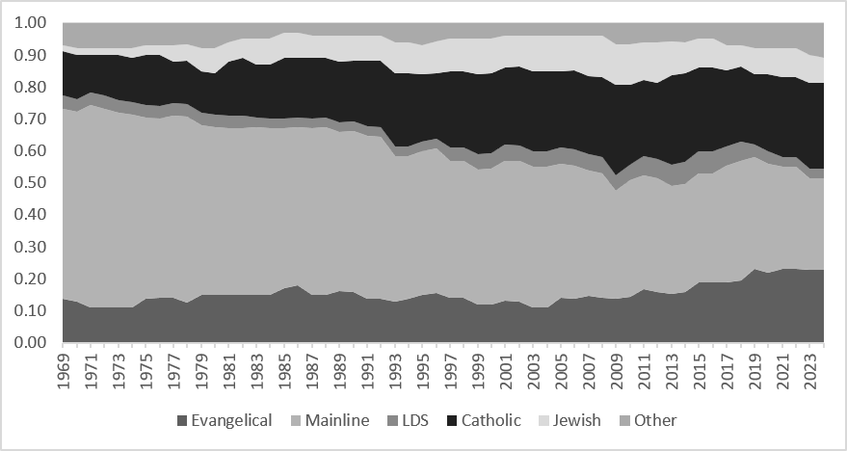
But that has changed overtime: Mainline Protestants used to be the overwhelming majority in the Senate, today they make up barely a plurality.

Slide 7
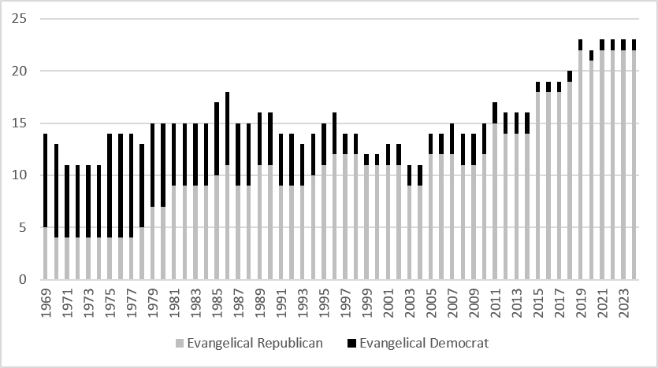
But the religious groups have realigned and “sorted” the past 55 years.

Slide 8



Are there consequences for the legislative process and for political parties brands? (Or, why we analyze roll-call voting?
Beyond Symbolism
Ultimate Priorities
Defining Brands
While bill sponsorship is a voluntary signal of intensity, roll calls force every legislator to stand on the record under direct, public pressure.
What a government funds and puts its votes behind remains the ultimate structural expression of its actual values and political commitments.
The aggregate distribution of roll-call votes refines both individual member records and high-level, macro-partisan brands over time.

Slide 9

Cultural Issue Score Data & Methodology
THE CULTURAL ISSUE SCORE (CIS)
We construct Yearly and Career-level Cultural Issue Scores tracking annual positions on intense cultural conflicts.
Cultural Issue Score Composition (375 Votes)
Reproductive Rights (55%): Abortion access, birth control, contraception, and fetal personhood legislation.
Comprehensive Index: Runs from 0 (perfectly conservative) to 1 (perfectly liberal) utilizing non-unanimous roll-call votes.
LGBTQ Rights (15%): Same-sex marriage bans, Boy Scout policies, military inclusion, and school expression.
Annual and Total: Analyzed by year (1971–2024) to isolate election-year incentives and dynamic agenda changes as well as career-level and Volatility across career (stability).
Remaining Issues (30%): Women's rights (10%), free exercise of religion (9%), capital punishment (7%), stem cell research (2%), public art funding (2%).
Rigorously Sourced: Compiled from Senate Library archives and cross-referenced with scorecards

Slide 10

Ideological Profiles on Cultural Votes (1971–2024)
Demographic Group | Mean Cultural Issue Score (CIS) | Mean DW-NOMINATE Score | Core Profile Description
Evangelical Protestants | 0.19 (0.07 Rep / 0.52 Dem) | 0.37 (0.28 Rep / 0.62 Dem) | Form the structural anchor of the cultural "Right"
LDS (Mormon) | 0.23 (0.09 Rep / 0.63 Dem) | 0.38 (0.28 Rep / 0.66 Dem) | Stalwart conservatives; highly influenced by state demographics
Roman Catholics | 0.58 (0.15 Rep / 0.85 Dem) | 0.54 (0.31 Rep / 0.67 Dem) | Cross-pressured by their religion between cultural and economic issues.
Mainline Protestants | 0.54 (0.28 Rep / 0.80 Dem) | 0.48 (0.32 Rep / 0.65 Dem) | Directly reflect the institutional chamber mean
Jewish | 0.87 (0.61 Rep / 0.93 Dem) | 0.65 (0.43 Rep / 0.69 Dem) | Anchor the cultural "Left"; GOP Jewish senators now extinct
Women (All Parties) | 0.78 (0.39 Rep / 0.97 Dem) | 0.57 (0.35 Rep / 0.67 Dem) | Significantly more liberal than male co-partisans
Gaps between demographic groups are much wider on cultural issues than on general legislative DW-NOMINATE scores.

Slide 11
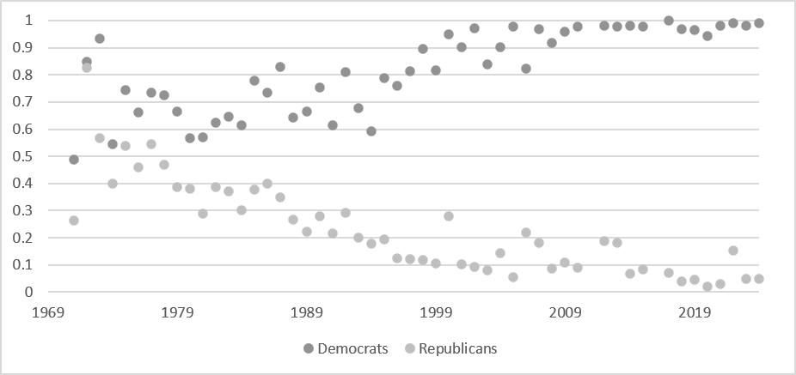
Partisan Polarization on Cultural Issues
. Since 2007, Democrats cluster near 1.0 (perfectly liberal) while Republicans remain bounded near 0.0 (perfectly conservative).

Slide 12
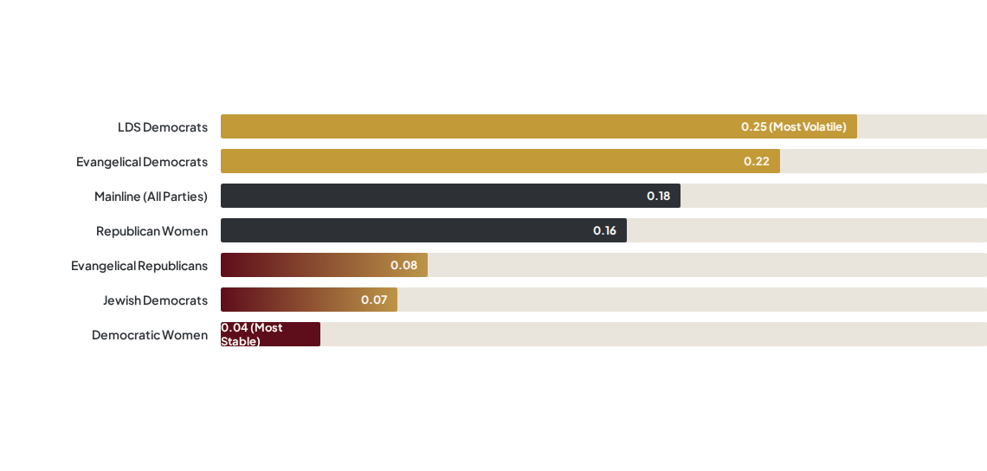
Who Flip-Flops? Volatility Across Faith & Gender
MEAN STANDARD DEVIATION OF INDIVIDUAL CAREER CIS SCORES
Identity friction drives career volatility; fully aligned identities yield maximum stability.

Slide 13

Determinants of Cultural Issue Voting (1971–2024)
Independent Variables | Cultural Issue Score (All Years OLS) | Career mean CIS Score | Volatility (GLM Career SD)
Evangelical | -0.140*** (0.039) | -0.261*** (0.049) | -0.048** (0.024)
Catholic | -0.101*** (0.033) | -0.097** (0.049) | -0.013 (0.021)
Jewish | 0.072 (0.047) | 0.164** (0.067) | -0.063* (0.033)
Female | 0.146*** (0.036) | 0.129** (0.056) | -0.006 (0.034)
LDS | (0.039) -0.080 | 0.129** (0.034) | -0.006 (0.056)
Other | 0.108* (0.047) | 0.177*** (0.042) | -0.030 (0.055)
Observations / R-squared | 5,168 / R² = 0.638 | 433 / R² = 0.339 | 418 / Gamma-log link
Notes: Mainline Protestant is the omitted reference group. Standard errors are clustered by senator. Significance levels: *** p < 0.01, ** p < 0.05, * p < 0.1.
Primary takeawayS Evangelical Senators have much more conservative and consistent CISs even when controlling for party.

Slide 14


The Decadal Shift & Partisan Cartelization
1970S & 1980S ERA
2010S TO 2024 ERA
Direct Demographic Impact
The Illusion of Party Power
Party effect was modest ($B \approx 0.28$). Individual religious identity and gender exerted direct, significant statistical influence on roll calls.
Party coefficient explodes ($B = 0.782^{***}$), completely absorbing direct religious effects. $R^2$ reaches a staggering 91%.
The Realignment Mechanism: Party appears dominant only because religious and gender identity first dictated party alignment. Realignment has institutionalized identity straight into party brands.
The models explain moderate variance as floor agendas were relatively open and less curated by central party leadership.

Slide 15
The Decadal Shift & Partisan Cartelization
Identity-Driven Voting: Beyond basic partisan polarization, the Senate's voting patterns on culture war issues are anchored by deep demographic sorting, where evangelical Protestant and LDS senators anchor cultural conservatism, while Jewish senators, minority faiths, and Democratic women anchor cultural liberalism.
Shifting and Split Groups: Mainline Protestants have maintained a steady moderation alongside their declining numbers, while Roman Catholic senators have experienced complete partisan capture, splitting strictly along party lines and abandoning past cross-pressured voting patterns.
Gender Nuances: Gender acts as a powerful cross-cutting force; Republican women historically vote nearly twice as liberally on culture war issues as Republican men, though the recent rise of conservative Evangelical women is pushing women's legislative roles toward the same hyper-polarized sorting seen among Catholics.
The Elimination of "Cross-Pressured" Senators: Senators with mismatched personal identities and party affiliations (like Evangelical Democrats or Jewish Republicans) experience intense career volatility, a tension that has ultimately resolved through their elimination from the chamber, leaving the modern Senate almost perfectly sorted by identity.

Slide 17
Key Theoretical Conclusions
Demographic Sorting Dictates Party:
Party labels appear to dominate behavior only because deep religious and demographic alignments first shaped party recruitment and defection pathways.
Identity Friction Eliminates Moderates:
Cross-pressured anomalies (such as Evangelical Democrats or Jewish Republicans) faced extreme internal tension, resulting in career volatility and eventual structural extinction.
Negative Agenda Control Hides Nuance:
Sweeping gatekeeping powers deployed by Senate majority leaders systematically prevent internal splits from being exposed on the floor, artificially inflating the statistical appearance of pure partisan voting.

Slide 18

Questions & Discussion
Forthcoming in "For God and Party: Religion, Representation, and American Political Parties" (Cambridge University Press, 2027).
John McTague, PhD — jmctague@towson.edu
Shanna Pearson-Merkowitz, PhD — spearson@umd.edu
Towson University & University of Maryland School of Public Policy

